Slide 1
Exploring the Association between Debt Ratio and Economic Development: A Developing Country Level Study
Team: COGNOS
Apr. 16, 2018
Yichen Pan, Quanxu Pang, Zihao Wang, Haojunzhi Yu, Junyi Huang

Slide 2
Problem Statement
Is there any association between debt ratio and GDP growth rate?
Analyzing data related to debt and economic indexes.
Try to find the associations between debt ratio and economic development of countries
Notes:
According to the historical data, debt ratio will have influence on the economic development. Sometimes it is positive, sometimes negative. It is important to find an appropriate debt ratio range that will positively affect economy.
By analyzing data related to debt and economic indexes, we try to find the associations between debt rate and economic development of countries and hopefully get the specific ranges of debt ratio that accelerates the growth of the economy best.

Slide 3
Importance
High debt model of development transfers the risk to the financial industry
Healthy debt ratio prevent financial crisis and regulate the fiscal policy and interest rate.
Governments can make adjustment according to their current situation.
Notes:
Since high debt model of development will transfer the risk to the financial industry, a healthy debt ratio is really important to prevent financial crisis and to regulate the fiscal policy and interest rate.
With ideal range of debt ratio of countries in different industrial structure, governments can make adjustment according to their current situation.

Slide 4
Hypotheses
The hypothesis is that there is an appropriate debt ratio range that is most conducive to economic development.
Appropriate debt ratio (40%-60%) of corporates [2]
Deduce some important aspects to adjust debt ratio in country level.
Notes:
Because an appropriate debt ratio (40%-60%) [2] can be used to increase leverage for individuals and corporates, we wonder that whether there is a similar pattern for country level economics.
Individual and corporates will make adjustment to debt ratio based on expected cash income and market condition. We can deduce some important aspects to adjust debt ratio in country level.

Slide 5
Dependent & Independent Variables
Independent Variables | Type | Scale
Concessional debt (% of total external debt) | Numeric | Ratio
Debt service on external debt, total (TDS) | Numeric | Interval
Exports & Imports of goods, services and primary income | Numeric | Interval
Short-term debt (% of total external debt) | Numeric | Ratio
Total debt service (% of exports of goods, services and primary income) | Numeric | Interval
Total reserves (% of total external debt) | Numeric | Ratio
Dependent Variables | Type | Scale
Current account balance | Numeric | Interval
Gross National Income (GNI) | Numeric | Interval
Primary income on FDI | Numeric | Interval
GDP | Numeric | Interval
# of years data, period:
9 years (2008-2016)
Data size:
129 countries*9 years*14 variables = 16,254
Data source:
http://data.worldbank.org/data-catalog/international-debt-statistics
http://data.worldbank.org/data-catalog/world-development-indicators

Slide 6
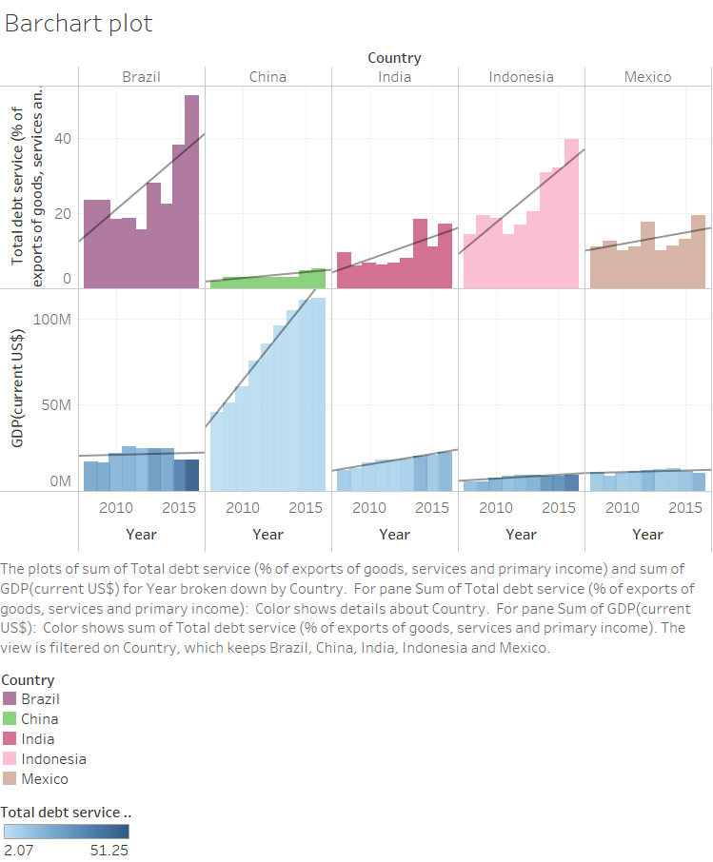
The bar-chart shows 5 countries’ sum of GDP and Total Debt Service as well as their trend lines between 2008 and 2016.
Maintaining lower and stable Total Debt Service might accelerate the growth rate of GDP.
For those countries with relatively high volume of GDP, lowering Total Debt Service is one solution to accelerate the GDP growth.

Slide 7
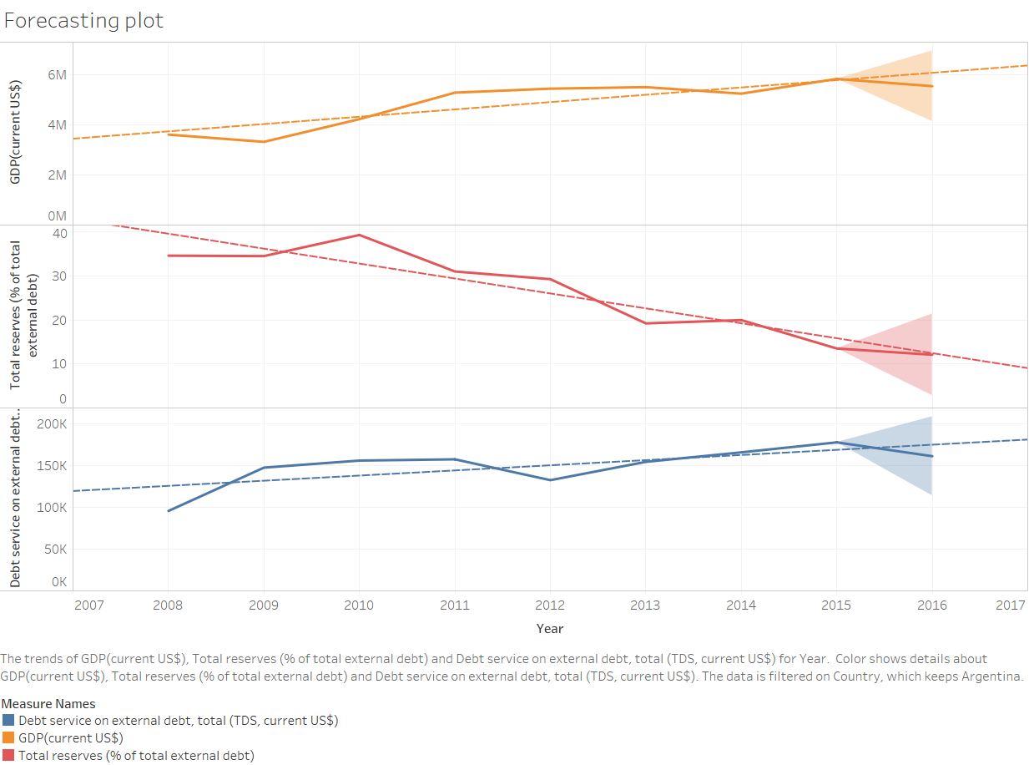
The Forecast plot uses Argentina’s 2008-2015 data (GDP, Total reserves, and Debt service on external debt) to predict 2016’s.
Total Reserves and Debt Services on external debt have lower forecasting data than actual data. Total Reserves has negative relationship with GDP, but Debt Service on external Debt has positive relationship with GDP.
Total Reserves is an important and valuable factors to study. Focus on the variation of Total Reserves on other countries’ situation is a reasonable direction.

Slide 8
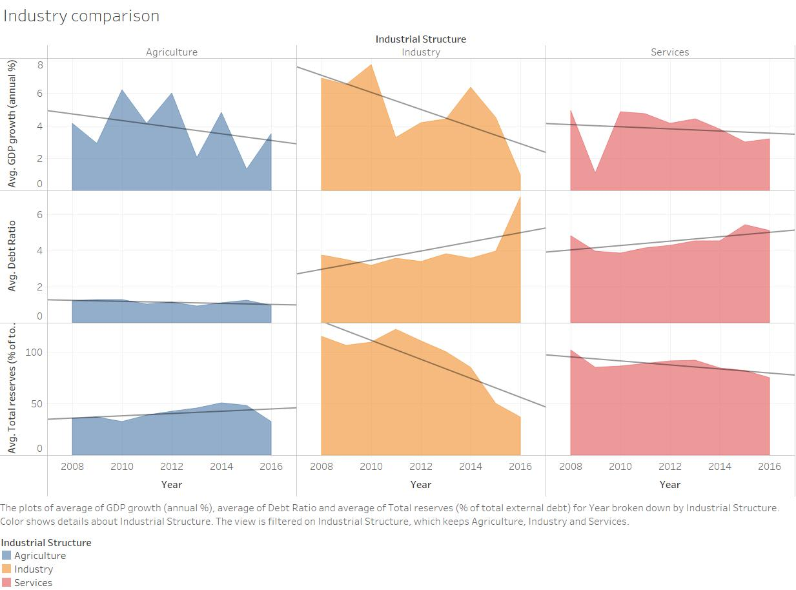
The chart shows the Avg GDP growth rate, Avg Debt Ration, and Avg Total reserves from each industry within 9 years.
Different relationship between GDP growth and Debt Ratio (Total reserves) in Agriculture and other two industries.
Development pattern in agriculture countries is different from other 2 types. Development of industrial countries are easier to be influenced by Debt ratio and Total reserves.

Slide 9
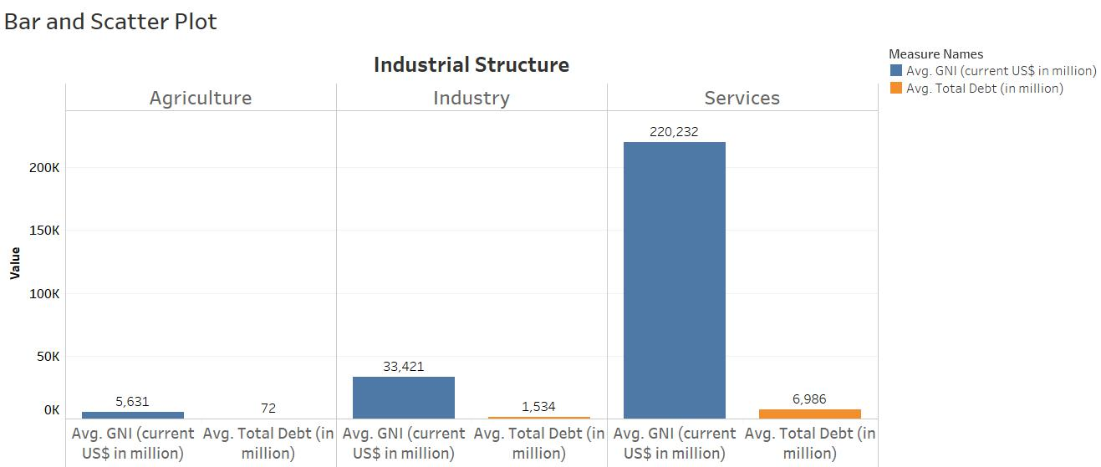
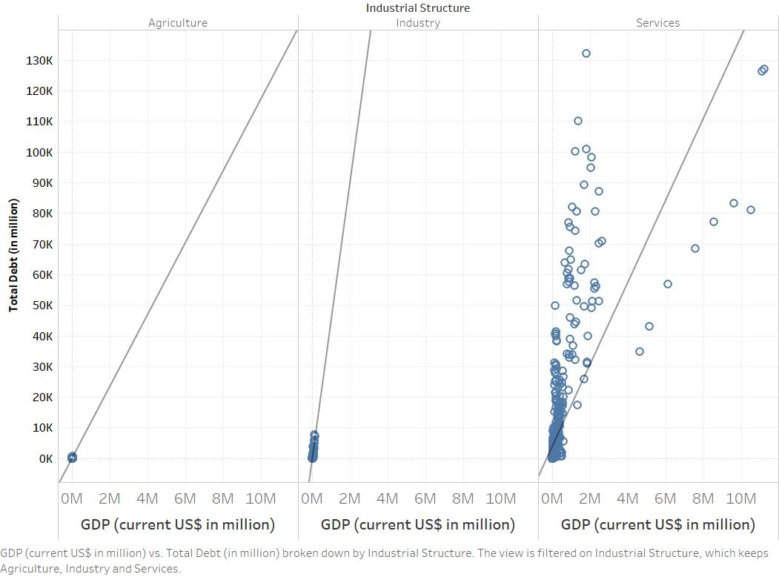
The bar chart shows the comparison of average total debt and average GNI of countries in different industrial structures. The scatter plot shows the trend of debt-to-GDP ratios.
The countries in tertiary industrial sector have highest gross national income and relatively high total debt as well; countries in secondary sector have the highest debt ratio.
Generally, the countries with relatively high GNI tend to have great debt-paying ability. Thus, for economies of scale reasons, they are likely to have high debt.

Slide 10
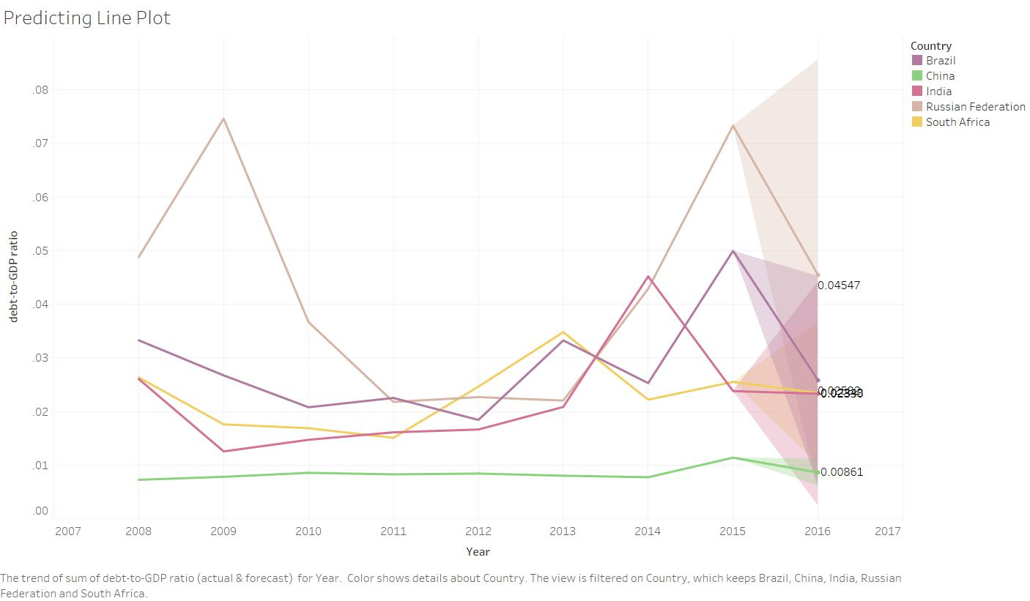
The line forecast chart shows the debt-to-GDP ratio of 5 countries from 2008 to 2015 and the estimated prediction value of 2016.
The chart depicts that the ratio fluctuates during the first years and the ratio of all five countries has different degrees of decline in 2016.
The decrease of debt-to-GDP ratio indicates that an economy produces and sells more goods and services to have the ability to pay back debts, instead of having further debt.

Slide 11
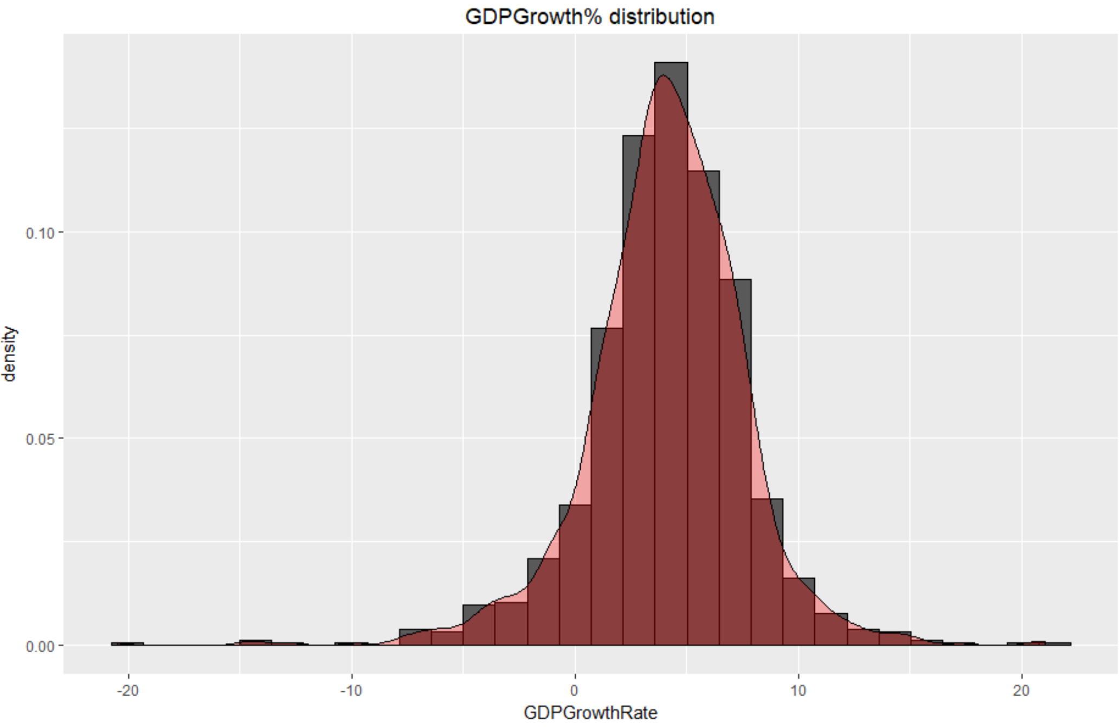
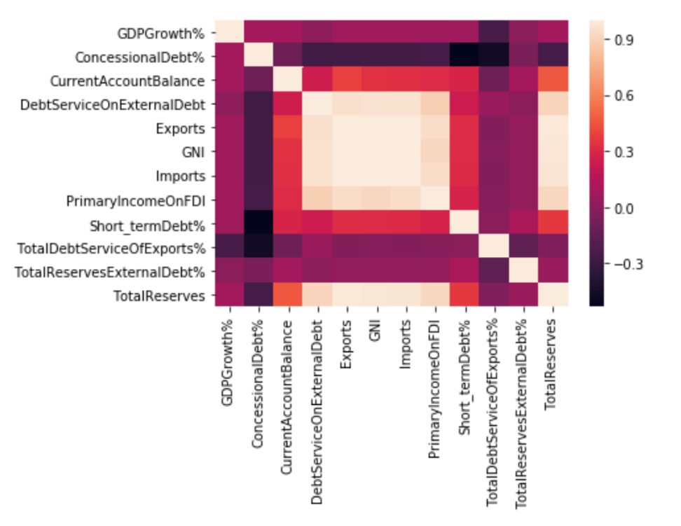
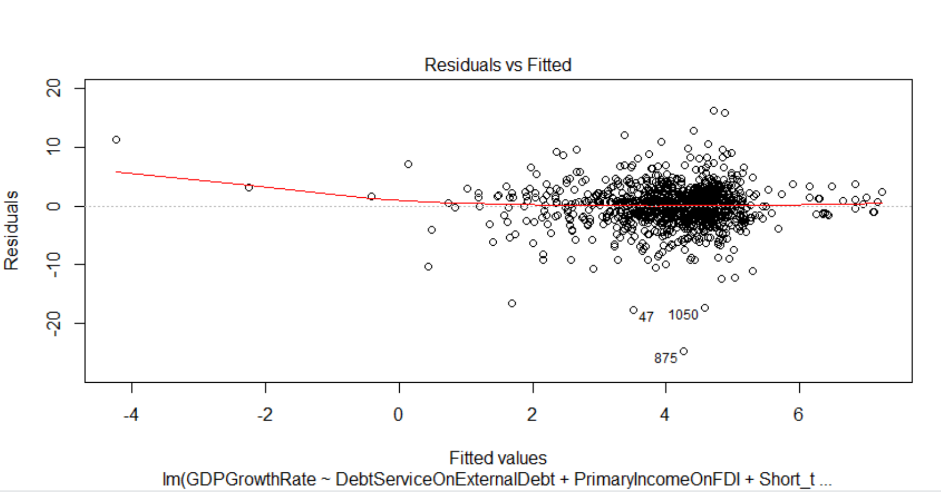
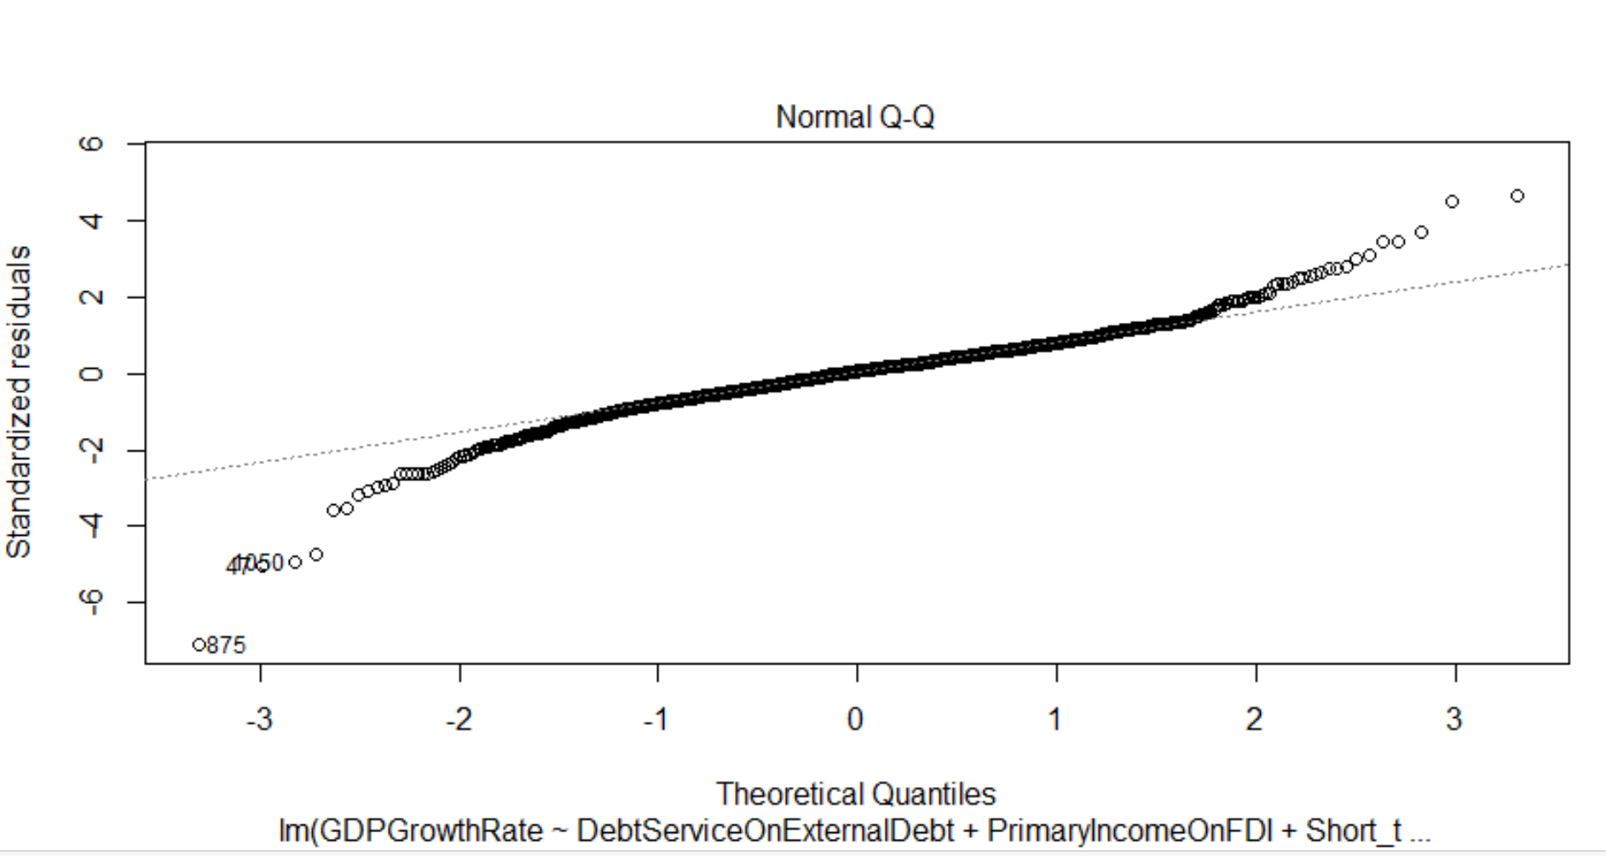

Slide 12
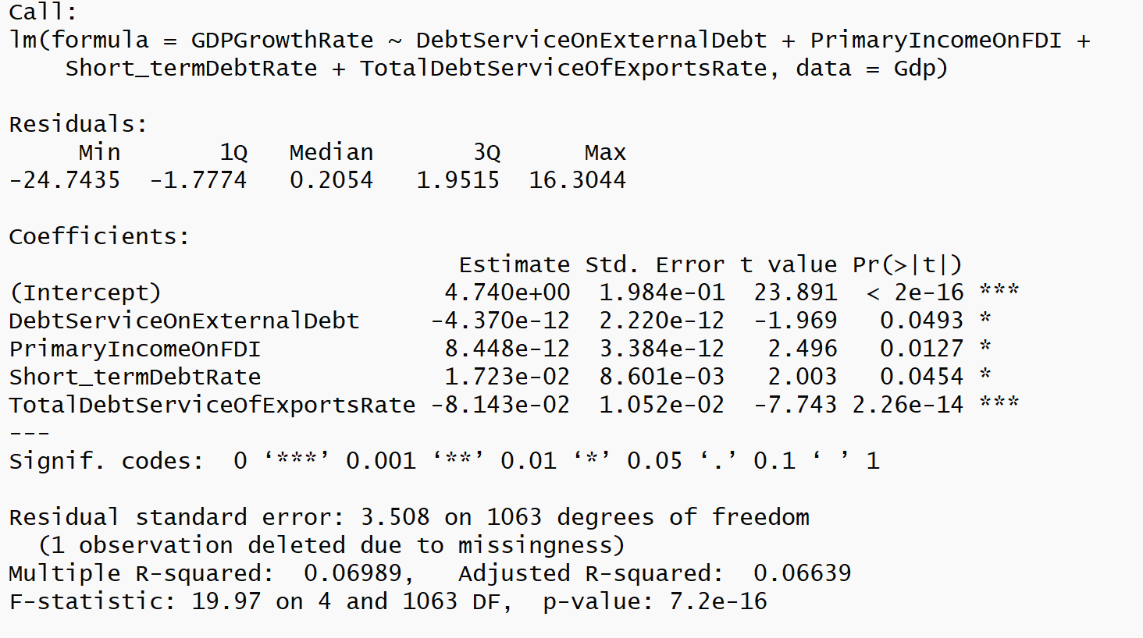
The results of our linear regression model is
GDPGrowthRate = 4.74 – 4.37e-12Debt Service On External Debt + 8.448e-12 PrimaryIncomeOnFDI + 1.723e-02 Short_termDebtRate – 8.143e-02 Total Debt Service of ExportsRate

Slide 13
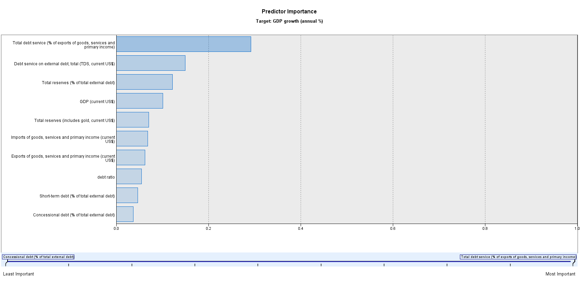
Neural Network for GDP Growth Rate

Slide 14
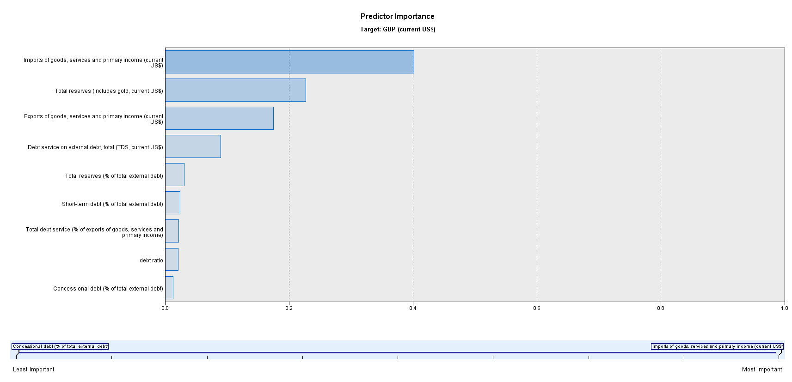
Neural Network for GDP

Slide 15
Scope & Limitations
The study only researches the debts and economic data of developing countries, not worldwide.
The period of study is 9 years, which may cause great fluctuations on exchange rate.
This is just an economic study which considered without politic factors.

Slide 16
Conclusions & Future Research
Conclusion:
Although there isn’t a strong association between debt ratio and economic development measurement parameters. National governments should still pay close attention to their debt ratio since total debt service showed a 1st position influential effect.
Future Research:
In order to make further advanced studies on correlation between debt ratio and GDP growth rate, we are supposed to take exchange rate, currency liquidity and trade dependency into consideration.

Slide 17
Managerial Implications
Study result of debt ratio can be used as a threshold to remind countries that they are in high debt risk. And the result can also be used by commercial banks or financial organizations.
Government could take the result into consideration while evaluating issuing treasury bonds.
Credit rating companies could evaluate countries based on different structures according to the study.

Slide 18
References
[1] Wade, Robert, and Frank Veneroso. "The Asian crisis: the high debt model versus the Wall Street-Treasury-IMF complex." New Left Review 228 (1998): 3.
[2] Corporate Finance: European Edition, by D. Hillier, S. Ross, R. Westerfield, J. Jaffe, and B. Jordan. McGraw-Hill, 1st Edition, 2010.
[3] Caner, Mehmet, Thomas J. Grennes, and Friederike Fritzi N. Köhler-Geib. "Finding the tipping point-when sovereign debt turns bad." (2010).
[4] Kimberly Amadeo, Debt-to-GDP Ratio: How to Calculate and Use It, January 27, 2018
[5] https://data.worldbank.org/data-catalog/international-debt-statistics

Slide 19
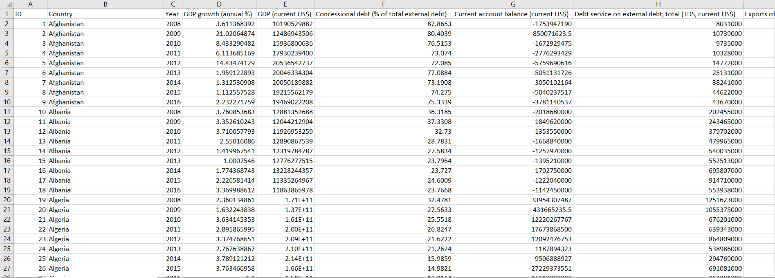
Sample data for analysis

